Slide 1
The Concept Of Discovery
A reading of the rubric

Slide 2
The place of the Area of Study
Notes:
When we get a new prescriptions list, it is always a good idea to revisit the syllabus – as indeed we are asked to do at the beginning of each module. So what is the role of the AoS in student learning at Stage 6.
Each area of the syllabus has a different learning focus and in not privileging any no particular theoretical approach, it does allow teachers and faculties to work with their preferences. Having said that, when finding a structure that is going to keep assessors happy in its capacity to spread the candidature as well as combining the different elements of the 2 syllabuses. The result is a common content that is akin to cultural studies.

Slide 3
Cultural Studies
A diverse field embracing
Different disciplines
Different approaches and methods
High and popular culture
Everyday meanings and practices
Perfect!
Notes:
You would think.
But the problem is that the discipline of Cultural Studies has always been contentious – even among its own adherents.

Slide 4
Area of Study
An Area of Study is the exploration of a concept that affects our perceptions of ourselves and our world.
Students explore, analyse, question and articulate the ways in which perceptions of this concept are shaped in and through a variety of texts.
Notes:
Meaning is central to the study of English and Cultural Studies is the study of how a society creates and shares meaning.
A foundational principle of Cultural Studies is that persons and groups interacting in a social system create, over time, concepts or mental representations of each other's actions, and that these concepts eventually become habituated into reciprocal roles played by the actors in relation to each other.
So we need to create learning opportunities for students to understand how the concept of discovery, as it is, and possibly as a defining contrast, as it has previously been understood. The very changing perception of discovery, of ourselves as discoverers and of the world as a place where discovery is valued is a product of social, historic and cultural contexts. These learning opportunities are developed through students’ engagement with texts - texts that invite speculation about the perception of what the idea of discovery is and the significance of the idea of discovery for its time and place.

Slide 5
Syllabus / Prescriptions
Syllabus
An Area of Study is the exploration of a concept that affects our perceptions of ourselves and our world.
Prescriptions
This Area of Study requires students to explore the ways in which the concept of discovery is represented in and through texts.
Notes:
The prescriptions need to be read within the context of the syllabus.
Is the concept/ the notion / the very idea of discovery one that affects our perceptions of ourselves and our world?
It can be and for a student to achieve well in an Area of Study, it will have to be.
It is much more natural for students to slip into discussing the way that a particular discovery (such as penicillin, the “new world”) affects our perceptions of ourselves and our world. This move from the abstract to the concrete of course lowers the cognitive level of the study and condemns as student to a C range.
✓
Discovery can be an idea developed in texts, but then composers can also discover through their composing of the text and audiences can discover through their responding to texts. In and through texts also indicates the way the text accepts certain values and then reinforces and disseminates them.

Slide 6
Possibilities about its nature
Discovery can encompass the experience of discovering something for the first time or rediscovering something that has been lost, forgotten or concealed. Discoveries can be sudden and unexpected, or they can emerge from a process of deliberate and careful planning evoked by curiosity, necessity or wonder. Discoveries can be fresh and intensely meaningful in ways that may be emotional, creative, intellectual, physical and spiritual. They can also be confronting and provocative. They can lead us to new worlds and values, stimulate new ideas, and enable us to speculate about future possibilities. Discoveries and discovering can offer new understandings and renewed perceptions of ourselves and others.
Notes:
Looking in detail at the rubric
Note that we move very quickly from the concept to particular discoveries as illustrative of the concept.
From abstract noun to gerunds in the first sentence with the second sentence beginning with a plural. The transition from concept to concrete is pretty swift. Personally I would have liked to see more elaboration of the concept before getting down to particularities.
In this paragraph we see discovery as a process from initial stimulus to the way it is
revealed (sudden and unexpected, deliberate and careful planning)
the effects it has on individuals (fresh and intensely meaningful emotional, creative, intellectual, physical and spiritual /confronting and provocative.)
the way we see the world.
So we are asked to trace the concept from its initiation through stages to the final significance.
The impact of discoveries noted here is not exhaustive; discoveries can lead to other discoveries.
Students should be open to other possibilities regarding the nature of discovery as they explore their texts so that they can move
from statements about specific discoveries
to generalisations about the nature of discovery and then
to considering how the concept of discovery is understood today in our own culture.

Slide 7
The elaboration continues…
An individual’s discoveries and their process of discovering can vary according to personal, cultural, historical and social contexts and values. The impact of these discoveries can be far-reaching and transformative for the individual and for broader society. Discoveries may be questioned or challenged when viewed from different perspectives and their worth may be reassessed over time. The ramifications of particular discoveries may differ for individuals and their worlds.
Notes:
There are no abstract nouns in this paragraph, only common nouns and a gerund. The temptation not to address the concept could be strong for some students.
In this section of the rubric context is the main issue here. Context varies, the impact varies and discoveries may be questioned, challenged and reassessed. The problem here is that students should not be carrying out these activities on discoveries but on the concept of discovery itself. Remember we are exploring a concept that affects our perceptions of ourselves and our world, not how the individual instances of discovery affect us.
To address these ideas, students could consider the representation of discovery from different perspectives:
the composer’s time and cultural context
the period, personal and social situation and cultural context of those responding to the text dealing with discovery.

Slide 8
Discovery as a concept?
By exploring the concept of discovery, students can understand how texts have the potential to affirm or challenge individuals’ or more widely-held assumptions and beliefs about aspects of human experience and the world. Through composing and responding to a wide range of texts, students may make discoveries about people, relationships, societies, places and events and generate new ideas. By synthesising perspectives, students may deepen their understanding of the concept of discovery. Students consider the ways composers may invite them to experience discovery through their texts and explore how the process of discovering is represented using a variety of language modes, forms and features.
Notes:
Good to see some abstract nouns here.
This first sentence seems to invite a critical reading of the assumptions underlying our understanding of the concept of discovery which is the heart of the Area of Study. But the assumptions referred to are about “aspects of human experience”, not about the nature of discovery, how discovery as a concept affects the way we see the world … and then the rubric goes back to “discoveries”. Students will need to take care to ensure that they move their arguments from the experience of discovery as a particular event or as a generalisation to address the issues at the heart of an Area of Study, our understanding of discovery as a concept.
This next sentence provide more examples of discovery. The focus is on the responder making discoveries, even if the composer shapes the experience to a degree. But students need to be reminded that composers can make discoveries through the process of composing – discoveries of an emotional or intellectual nature, discoveries about themselves or the world they live in.
Students are then asked to “synthesise perspectives” – but perspectives on what? In this theme position in the sentence one would expect this to be referring back to something. The closest noun is “discoveries” but surely the Area of Study asks them to synthesise perspectives on assumptions and beliefs which go into our understanding of the concept. To prepare our students adequately to address an Area of Study we need to assume that these perspectives are on the concept and not on the discoveries themselves. This judgement is borne out in the next section of the rubric.

Slide 9
What students do
In their responses and compositions, students examine, question, and reflect and speculate on:
their own experiences of discovery
the experience of discovery in and through their engagement with texts
assumptions underlying various representations of the concept of discovery
how the concept of discovery is conveyed through the representations of people, relationships, societies, places, events and ideas that they encounter in the prescribed text and other related texts of their own choosing
how the composer’s choice of language modes, forms, features and structure shapes representations of discovery and discovering
the ways in which exploring the concept of discovery may broaden and deepen their understanding of themselves and their world.
Notes:
This section begins with the student experience, their actual experience and their experience of discovery in their responding to and composing texts. They are asked to interrogate assumptions underlying representations of discovery and examine how these representation are shaped by language and form and the last dot point brings us to students’ reflecting on how their work in the Area of Study, on representations of concept of discovery, helps them understand themselves and their world. This last section of the rubric is the best advice on how to address the concept of discovery by outlining what students need to do.
This is a very long rubric, one that offers many opportunities for examination questions – and we all know from experience of past examinations that many have grown directly out of the rubric. I would caution teachers about this practice as, from this analysis it is evident that sections of this rubric do not necessarily go to the heart of the learning required for an Area of Study.

Slide 10
The Concept of Discovery Panel ETANSW Conference 2013
Panellist:
Tony Britten
“Discovery is metaphor”
tony.d.britten@gmail.com
Image:
http://upload.wikimedia.org/wi
ipedia/commons/5/5f/T
O_Mappa_mundi.jpg

Slide 11
http://cdn.twentytwowords.com/wp-content/uploads/polyp_cartoon_yuppie_tourism.jpg

Slide 12
Discovery is metaphor
Etymology: discover
discovrir (Old French): to unroof or unveil
Image: http://onsophiastreet.com/2013/08/29/unveiling/

Slide 13
Rubric for Area of Study: Discovery
“This Area of Study requires students to explore the ways in which the concept of discovery is represented in and through texts.”
http://www.boardofstudies.nsw.edu.au/syllabus_hsc/pdf_doc/english-prescriptions-2015-20.pdf

Slide 14
Simultaneous or multiple discovery versus heroic discovery or invention
A Field of Violets by Raymond Gehman
http://www.seasonedwithlove.com/the_rainbow_bridge_brent_hunter.htm

Slide 15
"When the time is ripe for certain things, they appear at different places in the manner of violets coming to light in early spring.“
- C18th century Hungarian mathematician Farkas Bolyai

Slide 16
Rubric for Area of Study: Discovery
“Students consider the ways composers may invite them to experience discovery through their texts and explore how the process of discovering is represented using a variety of language modes, forms and features.”
http://www.boardofstudies.nsw.edu.au/syllabus_hsc/pdf_doc/english-prescriptions-2015-20.pdf

Slide 17
The Impossible Hamster: animation from the new economics foundation
http://www.neweconomics.org/press/entry/economic-growth-no-longer-possible-for-rich-countries-says-new-research
http://www.impossiblehamster.org/

Slide 18
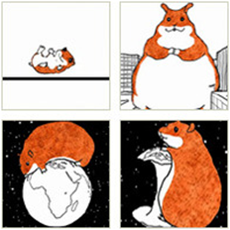
Available for free on Youtube and Vimeo
http://www.youtube.com/watch?v=Sqwd_u6HkMo
http://vimeo.com/8947526

Slide 19
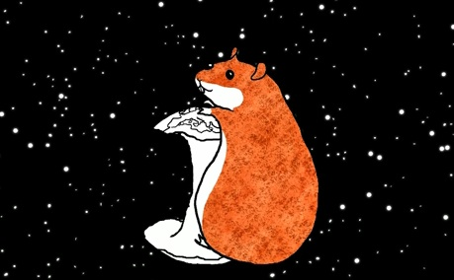
Anders Lustgarten: BBC radio play version of The Impossible Hamster
“As a political playwright do not convey information. Try and find something to carry that- and
that is the key role of metaphor.”
http://www.neweconomics.org/blog/entry/the-impossible-hamsters-radio-debut

Slide 20
If There Is I Haven’t Found It Yet by Nick Bloom (2009) 2012 production at Roundabout Theatre
http://www.roundabouttheatre.org/shows-events/if-there-is.aspx

Slide 21
If There Is I Haven’t Found It Yet by Nick Bloom (2009) 2012 production at Roundabout Theatre
http://www.roundabouttheatre.org/shows-events/if-there-is.aspx

Slide 22
http://www.roundabouttheatre.org/shows-events/if-there-is.aspx

Slide 23
http://www.roundabouttheatre.org/shows-events/if-there-is.aspx

Slide 24
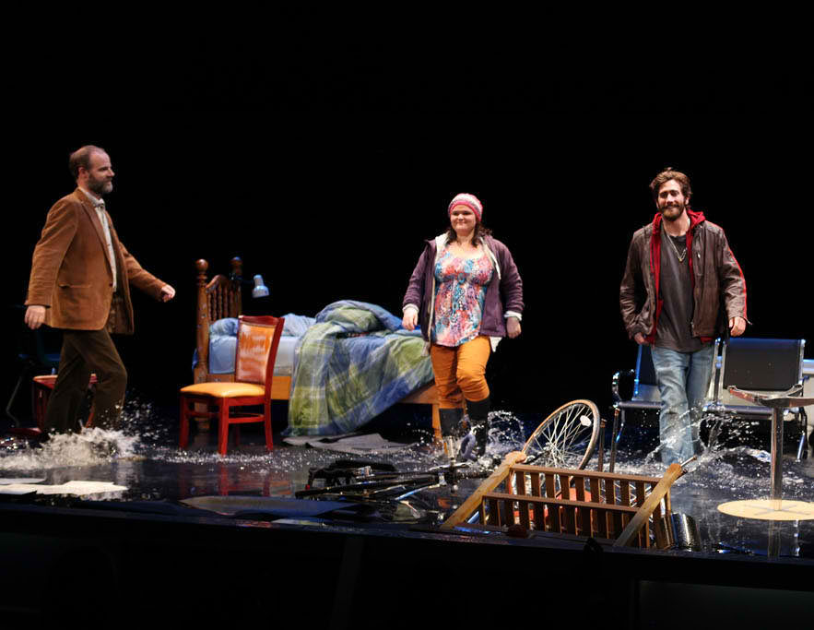
If There Is I Haven’t Found It Yet by Nick Bloom (2009) 2012 production at Roundabout Theatre
http://www.roundabouttheatre.org/shows-events/if-there-is.aspx

Slide 25
Craig Arnold: “Pitahaya”
Poetry Foundation
Poetry journal, October 2013
http://www.poetryfoundation.org/poetrymagazine/poem/246470
Image: http://www.poetryfoundation.org/bio/craig-arnold

Slide 26
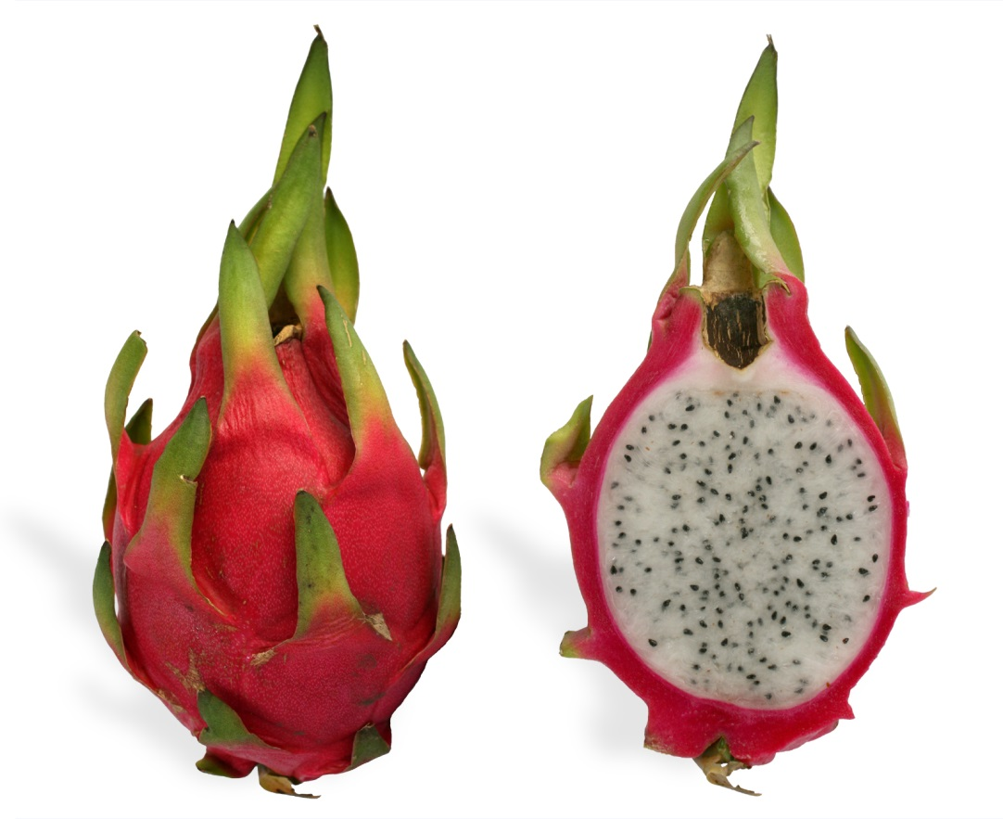
pitahaya, dragon fruit or thanh long
http://upload.wikimedia.org/wikipedia/commons/3/3c/Yellow_pitaya.jpg
http://en.wikipedia.org/wiki/File:Pitaya_cross_section_ed2.jpg

Slide 27
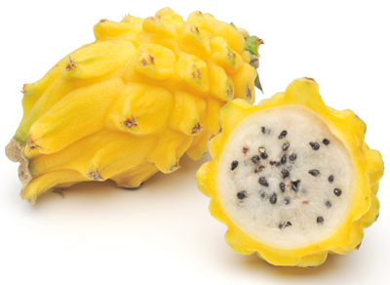
“Teach me a fruit of your country I asked…”
Teach me a fruit of your country I asked and so you dipped
into a shop and in your hand
held me a thick yellow pine cone
from “Pitahaya” by Craig Arnold
http://www.toucanfruit.com/our-range/fruit/dragon-fruit/

Slide 28
From Paterson: William Carlos Williams
“A dissonance in the valence of Uranium led to the discovery
Dissonance (if you’re interested) leads to discovery”
“yellow pine cone”: dissonance of adjective and noun leads to discovery of the nature of the fruit by the reader
From Williams, William Carlos, Paterson, New Directions Publishing, 1995

Slide 29
“Short short stories”
title
limited number of characters
limited plot
limited number of ideas explored
“explodes a moment”
framed and deliberately structured narrative
Stimulus:
opening line of a piece of imaginative writing about Discovery:
“Teach me a food of your country…”

Slide 30
The Japanese island of Kuchinoerabujima and US poet Craig Arnold
http://latimesblogs.latimes.com/.a/6a00d8341c630a53ef0115707a7abc970b-800wi
http://www.geographic.org/photos/volcanoes/volcano_photos_35.html

Slide 31
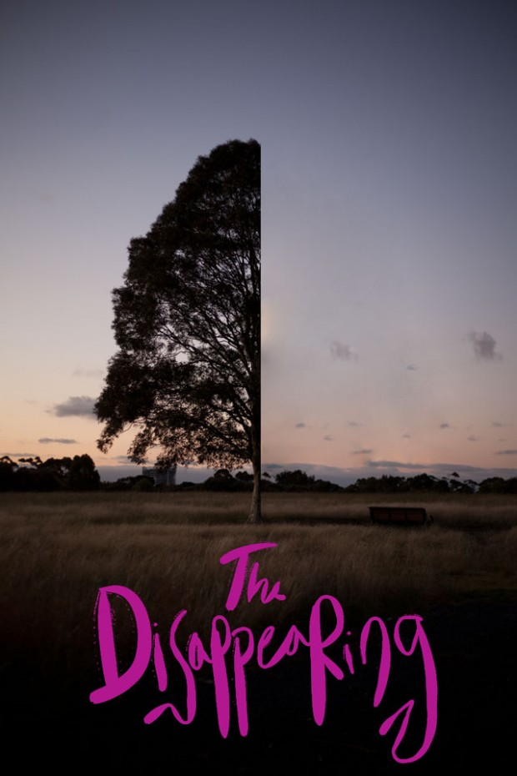
Discovery through The Disappearing
a free app based public poetry project from The Red Room Company that geo-locates hundreds of contemporary Australian poems to the place that inspired them
See the App stores for Apple and Android
http://redroomcompany.org/projects/disappearing/

Slide 32
Thank you
“Poems are for exploration, discovery, transformation. They would be very dull otherwise. But not necessarily personal discovery – the idea of poetry primarily for therapy is pretty pointless, don’t you think?”
- Jo Shapcott
http://lidiavianu.scriptmania.com/jo_shapcott.htm
tony.d.britten@gmail.com

